Slide 1
Pixelated Image Detection & Correction
Team Name : Team_IT
Team members:
Bejisto Joseph.B
Kamalesh.B
VijayaKumar.M
Surya L
Kovendhan.P

Slide 2
Problem Statement
Title: Pixelated Image Detection & Correction
Content:
Current Challenges:
Manual image detection is time-consuming and prone to errors.
Existing automated systems lack accuracy and efficiency.
High cost and resource consumption in traditional methods.
Impact of the Problem:
Delays in decision-making processes.
Increased operational costs.
Lower overall productivity.
Objective:
To develop an AI tool that can accurately detect and correct pixels in real-time.
Enhance efficiency, reduce errors, and lower costs

Slide 3
Unique Idea Brief (Solution)
Innovative Approach:
Utilize advanced AI algorithms to enhance pixels detection accuracy.
Integrate real-time correction mechanisms to immediately rectify errors.
Key Features:
High Accuracy: Leveraging deep learning models for precise detection.
Real-Time Processing: Instantaneous analysis and correction.
Scalability: Adaptable to various industries and applications.
Cost-Effective: Reduces operational costs by minimizing errors and enhancing productivity
Technological Stack:
Machine Learning Algorithms: Convolutional Neural Networks (CNNs), etc.
Data Processing Tools: TensorFlow, OpenCV, etc.
Hardware: High-performance GPUs for faster computations.
Benefits:
Improved efficiency and reduced error rates.
Cost savings and increased productivity.

Slide 4
Features Offered
.
Accurate Object Detection:
Utilizes state-of-the-art machine learning models for high precision.
Capable of identifying a wide range of pixels in various pictures.
Real-Time Correction:
Immediate correction of detected errors to ensure accuracy.
Adaptive algorithms that learn and improve over time.
User-Friendly Interface:
Intuitive and easy-to-use interface for seamless operation.
Customizable settings to cater to different user needs.
Scalability and Flexibility:
Designed to handle large volumes of data without compromising performance.
Flexible integration with existing systems and workflows

Slide 5
Process flow
1.Data Collection:
Source: Kaggle DatasetsDataset
Names: pixelated image detection and correction and image_pro
Step: a.Download both datasets from Kaggle.
b.Combine the datasets into a unified collection of images.
2. Data Preparation:
Step:Separate the combined dataset into two directories: train and test.
Ensure a proper balance of pixelated and non-pixelated images in both directories.
3. Model Training for Pixelated Image Detection:
Model: Convolutional Neural Network (CNN)
Architecture:Conv2D layer with 8 filters, 3x3 kernel,
ReLU activationMaxPooling2D layer with 2x2 pool sizeConv2D layer with 16 filters, 3x3 kernel,
ReLU activationMaxPooling2D layer with 2x2 pool sizeConv2D layer with 32 filters, 3x3 kernel,
ReLU activationMaxPooling2D layer with 2x2 pool sizeFlatten layerDense layer with 32 neurons,
ReLU activationDropout layer with 0.5 rateDense layer with 1 neuron, Sigmoid activation.
Training:Use the train directory for training.
Validate using the test directory.Resulting model size: 96.5 MB.

Slide 6
Process flow
.
4. Model Optimization:
Step:Convert the trained CNN model to TensorFlow Lite (TFLite) format to reduce the model size.
Goal: Achieve a model size less than 10 MB.
5.Pixelated Image Correction:
Model: Super-Resolution Generative Adversarial Network (SRGAN)
Purpose: Upscale and correct pixelated images.
Process:Load the pre-trained SRGAN model.Preprocess the pixelated images.
Use SRGAN to generate high-resolution (corrected) images.

Slide 7
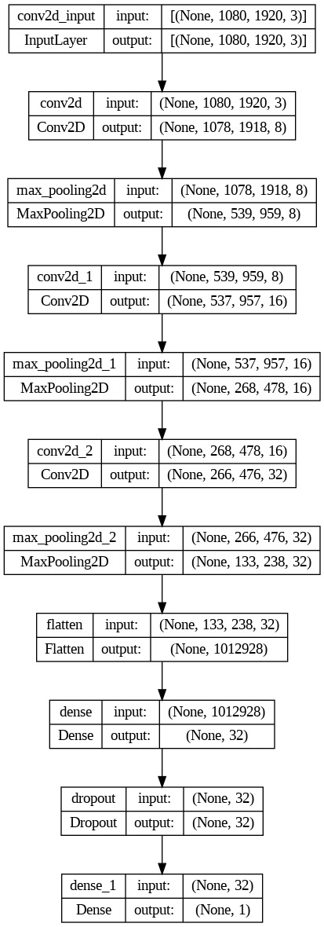
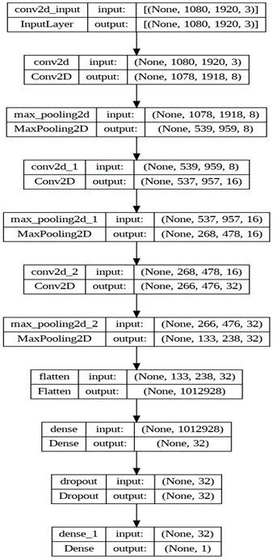
Architecture Diagram:

Slide 8
Technologies used:
1.TensorFlow
2. Keras
3. Pillow (Python Imaging Library)
4. Matplotlib
5. NumPy
6. ImageDataGenerator
7. scikit-learn
8. Modules for OS and Time.

Slide 9
Team members and contribution:
This project was a collaborative effort by a team of five . Each member contributed to different aspects of the project:
1.Bejisto Joseph.B : Data Collection,Model Architecture and Training. 2.Kamalesh.B : Model Evaluation and Quantization. 3.VijayaKumar.M : Upscaling Script and TFLite Integration. 4.Surya L : Documentation and Results Analysis. 5.Kovendhan.P : Project Coordination, Code Integration,Testing and GitHub Maintenance.

Slide 10
Conclusion
This project demonstrates the effectiveness of using a lightweight CNN model for classifying pixelated images and an SRGAN model for upscaling them.
The simplified CNN architecture successfully reduced the model size while maintaining acceptable performance metrics. The SRGAN model produced high-quality upscaled images, verified through both objective metrics and a subjective study.

